Slide 1

ROTPOTA:
Notes:
Paid/owned/earned.

Slide 2


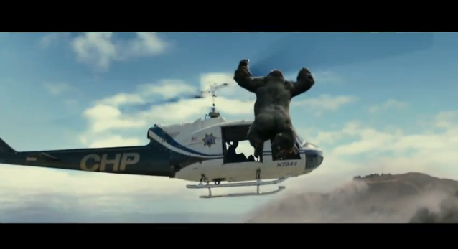

Background/Brief
DRIVING PURCHASE INTENT: ROTPOTA
Concept:
iP identified an opportunity to capture search interest pre-Christmas and pre launch of the ‘Rise of the Planet of the Apes’ (ROTPOTA) DVD/Blu Ray.
Working closely with Vizeum, iProspect made a bold recommendation to use “Search: Apes Will Rise” in place of a URL.
Objectives:
The aim - to drive awareness, consideration and ultimately sales of the ROTPOTA DVD & Blu Ray.
In doing so we encouraged users to search for a key term “apes will rise” to measure the effect of TV on search as well as maintaining sustained search interest after the big push of a movie title was over.

Slide 3


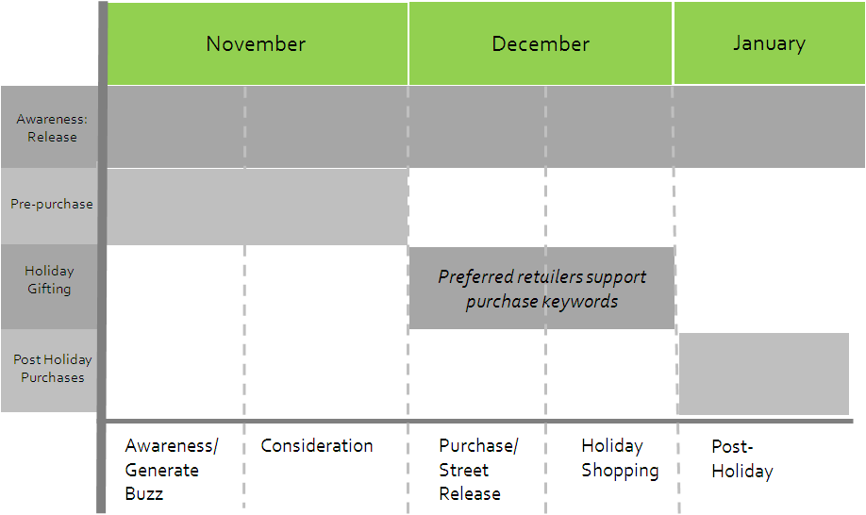

Strategy
ANTICIPATING THE USERS
Approach:
By identifying phases across the campaign lifetime, we were able to control the keyword types we were showing on in order to not only maximise our exposure during key periods, but also minimise showing against aggressive retailers during the Christmas season, instead our activity aimed to support the retailers by driving consideration & awareness.
The Search Landscape
In order to maximise our exposure, iP dominated across all 3 device types as well as using Media Ads to deliver fixed, low cost, rich media on the Search Results page; as a result we spread our net wide enough to capture users in any location and at all points of the buying cycle based on keyword selection.

Slide 4

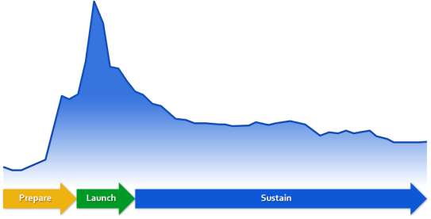
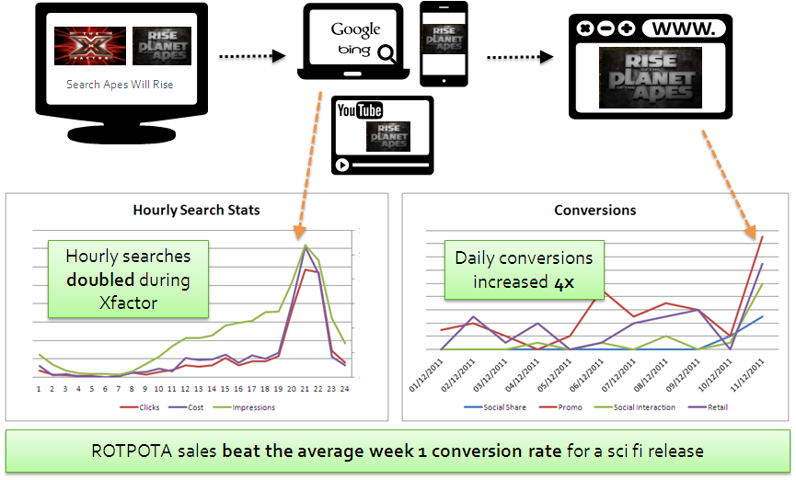
results
SUSTAINED SEARCH INTEREST
The Achievements:
The initial objective to drive consideration to purchase was quickly surpassed.
DVD & Blu Ray sales set the highest ever average week 1 conversion rate for any Fox Sci Fi release.
Achieved a CPC of just £1.12 against a benchmark CPC of £3.75
Results:
Following the TV commercial during the X Factor finale, searches for “apes will rise” increased dramatically with Clicks increasing exponentially hour over hour. With the increased traffic, our daily conversions also increased by 4.
Sustained Interest:
Our decision to maintain prolonged PPC activity allowed us to show that even after offline and other above the line media finish, PPC can continue to run and capture search demand.
Changing the thought process of the client.

